Slide 1
Related Work
Peer to peer decentralized network
Data replication
Connectivity

Slide 2

Related Work – P2P
BitCoin
Open-source P2P money / payment system.
Low transaction cost, less risky, secure, etc.

Slide 3

Related Work – P2P
Bitcloud
Decentralizing the Internet, creating Distributed Applications, and developing a new mesh network to replace the Internet.
Improve privacy, security, and ending Internet censorship.

Slide 4
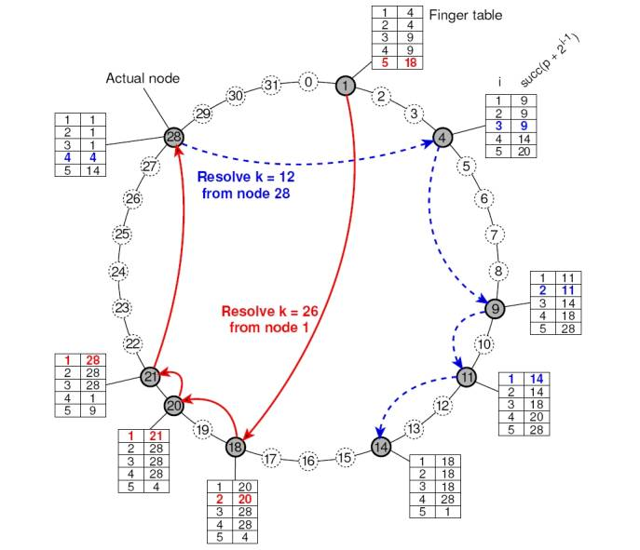
Related Work – P2P
Chord
Peer-to-peer lookup service for Internet applications
Each node maintains information for about O(logN) other nodes, resolves look up via O(logN) messages, and update routing information as nodes joining and leaving with O(log²N) messages

Slide 5
Related Work – Connectivity and Reachability
Connectivity and Reachability
Challenge
Cell phone providers block reachability.
Solutions
IPv6 (Mobile IP)
Approximately 3.4×10³⁸ addresses, 7.9×10²⁸ times as many as IPv4
The mobile nodes (as IPv6 nodes) change their point-of-attachment to the IPv6 Internet without changing their IP address.
Unmanaged Internet Architecture (UIA)
Conclusion
Largely solved issue
More for business reasons rather than technical
Not our main concern
Notes:
It is not enough for the device to have internet connectivity, but it must also be reachable from the internet.
Cell phone providers and WiFi access points hide their clients behind network address translation (NAT) or a firewall which blocks reachability from the internet.
UIA by MIT, solves the connectivity and reachability issue even in the current state of the internet, however it requires some assistance from devices with public IPs to enable NAT traversal.
[14] B. A. Ford, “Uia: a global connectivity architecture for mobile personal
devices,” Ph.D. dissertation, Massachusetts Institute of Technology,
2008.

Slide 6
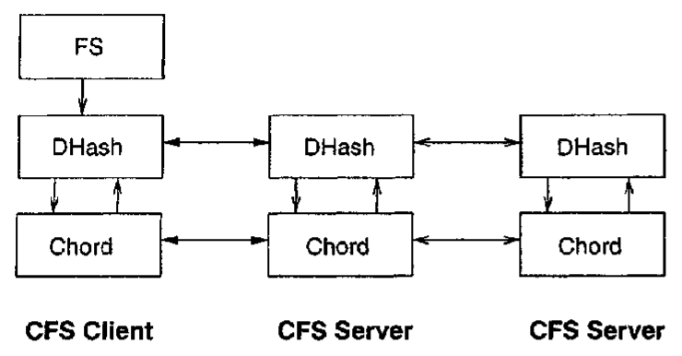
Related Work – Data Replication
Data replication
Cooperative File System (CFS)
Peer-to-peer read-only storage system that provides provable guarantees for the efficiency, robustness, and load-balance of file storage and retrieval.
(more?)

Slide 7
Related Work
Decentralized internet
Data replication
Connectivity
Peer to peer

Slide 8
Related Work - Decentralized Internet
Distributed online social network
Facebook => Persona
Twitter => Cuckoo
BitCloud
BitCoin

Slide 9
Related Work – Peer to peer
Peer to peer
Chord - MIT
Pastry
Etc.

Slide 10
Related Work – Data Replication
Data replication
CFS

Slide 11
Related Work – Connectivity and Reachability
Connectivity and reachability
UIA
IPv6 (Mobile IP)

